Slide 1
Selection
Notes:
Purpose:
Learn how a computer program can make decisions with the use of conditional blocks (selection).
Learning objective:
By the end of this tutorial children should be able to:
• Understand that programs need to make decisions based on certain conditions.
• Use conditional blocks in simple programs.

Slide 2
Algorithm
Sequence
Selection
Notes:
Introduce students to key vocabulary for this lesson:
Algorithm: An unambiguous procedure or precise step-by-step guide to solve a problem or achieve a particular objective.
Sequence: “When we sequence things, we arrange them in a particular order. Sequence-based algorithms are made from a precise set of instructions.”
Selection: (Refer to slide 4)

Slide 3
If raining outside bring an umbrella.
If not raining outside don’t
If sunny outside wear sunglasses.
If not sunny outside don’t
If hungry get something to eat.
If not don’t
Notes:
Very young pupils develop an understanding of selection in the world around them. For example, when playing a game which requires a set amount of players, “If more than 4 players then wait until there are fewer.”
They would have also used selection for choice made in the real world, “If it is warm outside, then I will not wear my coat”.”
Selection can become increasingly complex with multiple commands and may even start to combine (nesting) these to achieve a required result.

Slide 4
In computer science conditional statements (selection) can perform different computations or actions depending on whether a programmer-specified condition equals true or false.
Notes:
Explain to students about the importance of selection in computing/coding.
In computer science conditional statements/selection can perform different computations or actions depending on whether a programmer-specified condition equals true or false.
Selection is the programming structure through which a computer executes one or other set of instructions according to whether a particular condition is met. You can build selection into a sequence of instructions. This ability to do different things, depending on what happens as a program is running, makes programming a powerful tool. At the core of many educational games is a simple selection command: “If the answer is right then give a reward, otherwise (else) say the answer is wrong”. Selection statements can be “nested” inside one another, allowing more-complex sets of conditions to be used to determine what happens in a program.

Slide 5
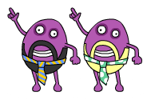
Notes:
Introduce Code Disco:
Children should be encouraged to try running their programs to see what happens. They should not always expect to get it right first time. Testing a program, seeing what goes wrong and then fixing the problem is a very important part of coding (debugging). Tutorials and challenges in Code Disco always build on what has been learned previously. Children should be encouraged to think about what they've just learned, and see how it can be adapted and extended to solve other problems. Breaking a problem down into simpler problems and then combining the solutions is a very useful strategy in coding.

Slide 6
Notes:
Introduce this new block.
The If () Then block is a control block and a C block. The block checks it is a Boolean expression (In computer science, a Boolean expression is an expression used in programming languages that produces a Boolean value when evaluated either “true or false”.
... The condition is only checked once; if the condition turns to false while the script inside the block is running, it will keep running until it has finished.

Slide 7
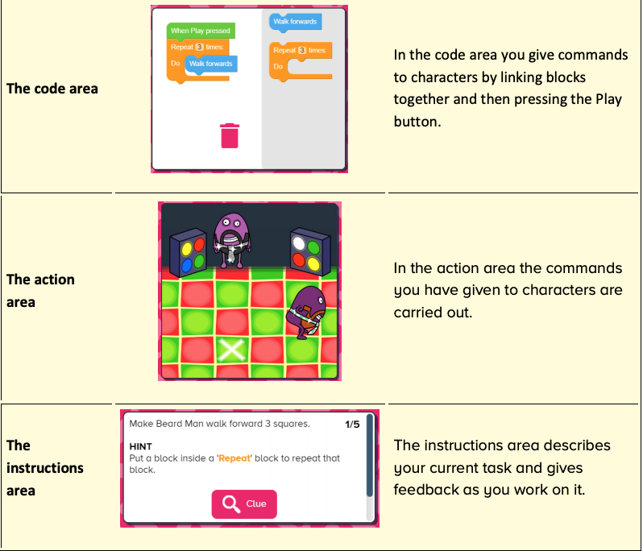
Notes:
Introduce students to Busy Code:
code area
action area
instructions area

Slide 8
Notes:
Tutorials (10/15 mins)
Tutorials consist of multiple steps that can be worked through.
The objective will be presented in the instructions area in the bottom left of the screen, along with any hints that may help children to complete the stage. Some steps include a clue button which will give a visual clue, normally where a new block type is introduced or an existing block type is used in a new way.
Once each stage is complete, a next button will appear allowing children to move onto the next stage.
Once the final stage has been completed, children can either try any related challenges or projects or can move onto the next tutorial.
You will want to demo this with your students going through the first instructions together.

Slide 9
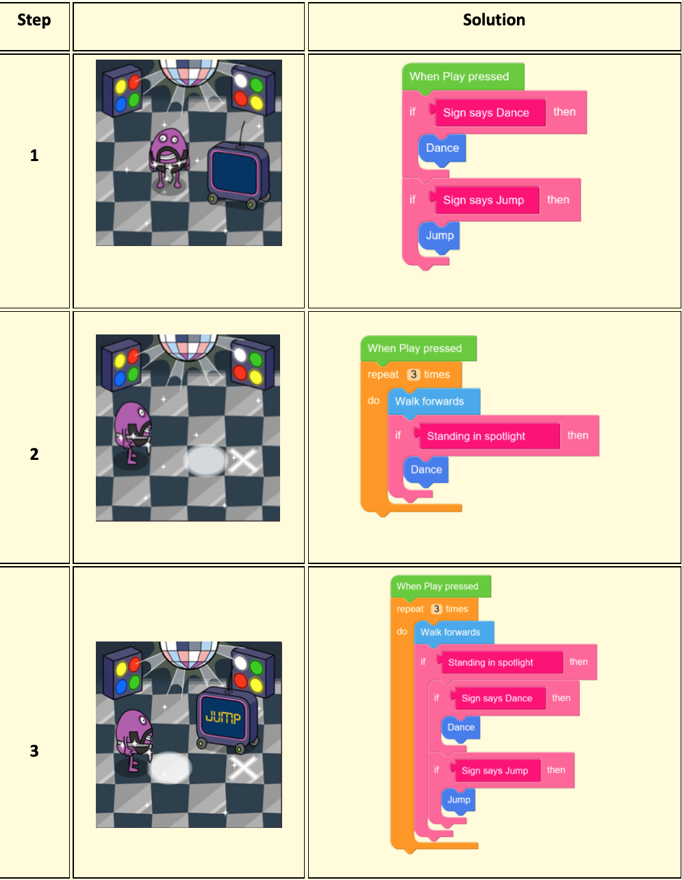
Notes:
Solutions for tutorial if needed.

Slide 10
Notes:
Challenge (10/15mins)
Use what you've learned in Tutorial 3 to try and complete the challenge, while staying within the suggested block limit. Challenge resources work in a similar manner to tutorial resources, but the problems are harder to solve. They are intended to test that children have grasped the concepts introduced in the preceding tutorials. Each task in a challenge has a suggested block limit the children should try to stay within.

Slide 11
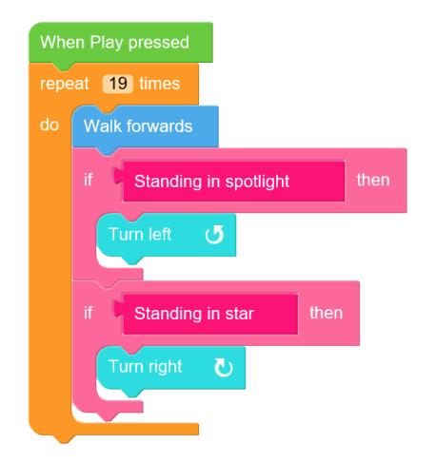
Notes:
Solution challenges may have many different correct solutions. Above is an example of a correct solution that doesn't exceed the block limit.

